Slide 1
EECE 5698
Robotics Sensing and Navigation
Homework 6 Data Analysis
Luxi Zeng

Slide 2
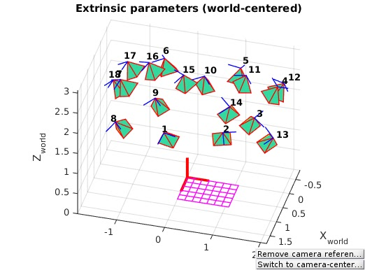
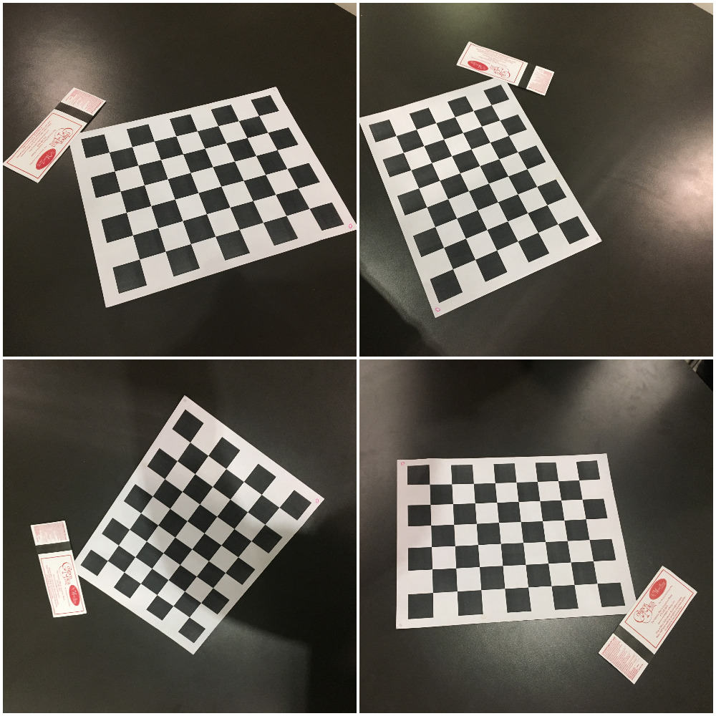
Camera Calibration
For the camera calibration part, I followed the tutorial from Caltech camera calibration toolbox, by taking the photo of the calibration pattern from different angles on the same plane.
The bottom four pictures are extracted from 18 pictures that I took for calibration.
The extrinsic plot is also matched with what is previously described.

Slide 3
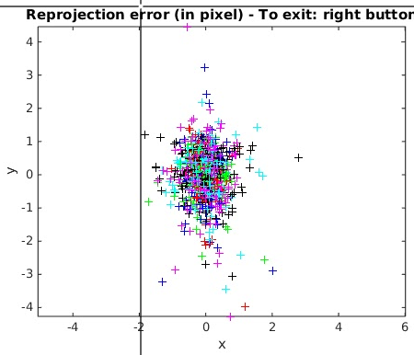
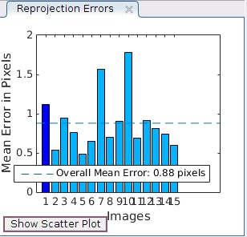
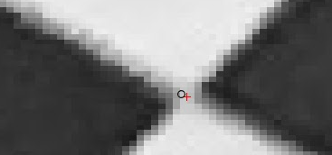
Reprojection Error
After doing the initial calibration and reprojection on the corner, I got the scatter plot showing the reprojection error for each plot as well as the overall mean.
As it shows in the left figures, the overall error is very closed to the center, and the overall mean error is around 0.88 pixels, which is reasonable to proceed.
For more detailed inspection, I zoomed in a random plot, to see the difference between labeled point and reprojection point. While the red “+” shows the labeled point and black “o” shows the reprojection point. As it can tell from the figure, they are very close with each other.

Slide 4
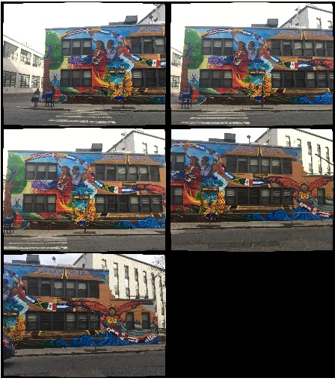
Image Compensation
After taking pictures of the Latino Students Center Building, I compensate those pictures with the parameter that I just got from the previous step.

Slide 5
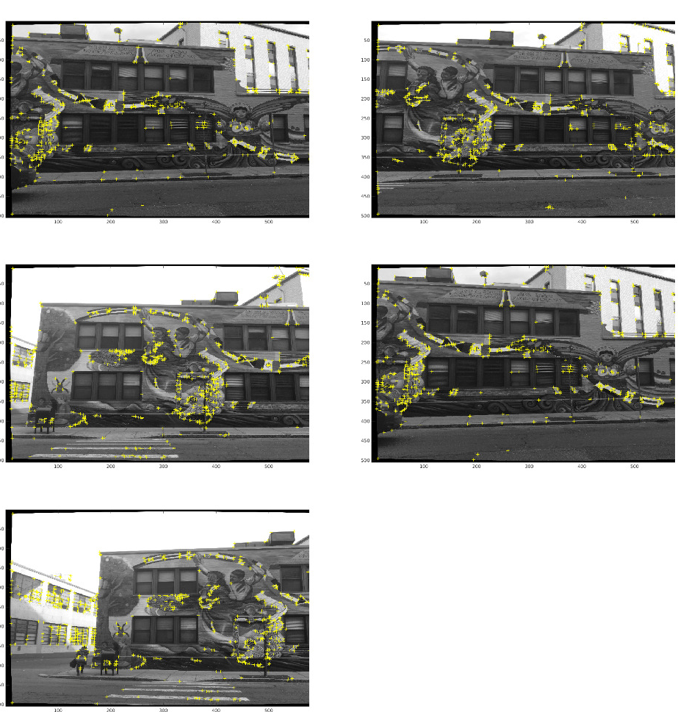
Harris Feature Detector
After applying the Harris feature detector, as it can be seen on the pictures, those featured points are shown clearly on the plot.
From my understanding of the harris feature detector, it will capture those featured point and then use them as a reference of getting panorama in the later steps.

Slide 6
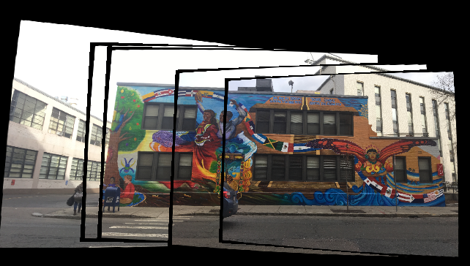
Output of panoramic mosaic of entire building
This is the output of panorama picture that I got by applying the harris feature detector, as it can be seen from the plot, the combination is done pretty well, except there is some gap between each plot, which is produced during the compensation stage.

Slide 7
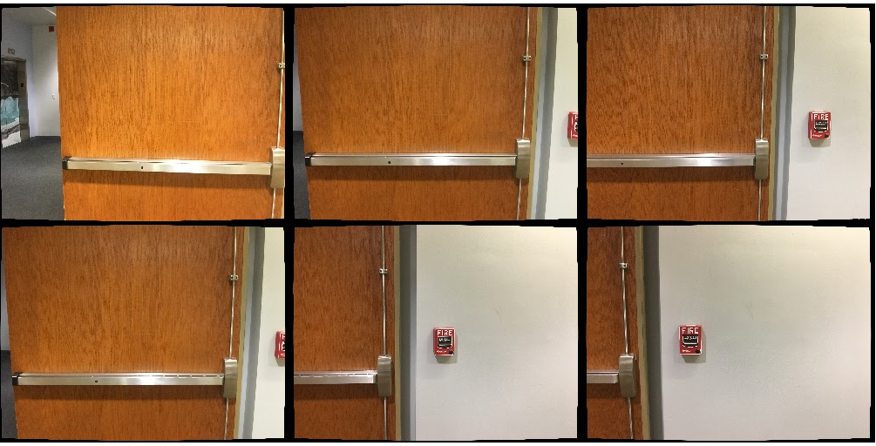
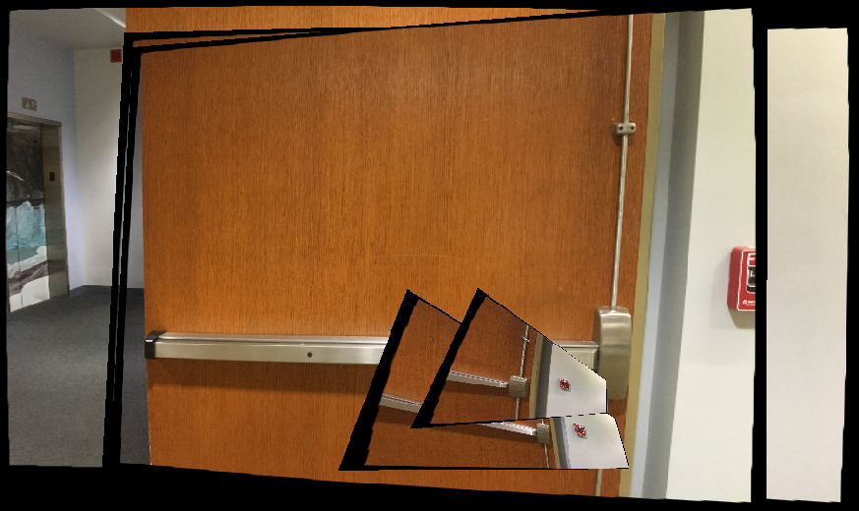
Cinder Block Wall
For the second set of data, I followed almost the same step with previous one.
The difference is at the picture taking stage. Rather than having a lot of overlapping area between each other, we would only have around 50% overlap between each other.
As it can be seen from the final panorama, it doesn’t look so good compared with the previous one.
For example the black gap grows larger, and some of the parts are even misplaced.

Slide 8
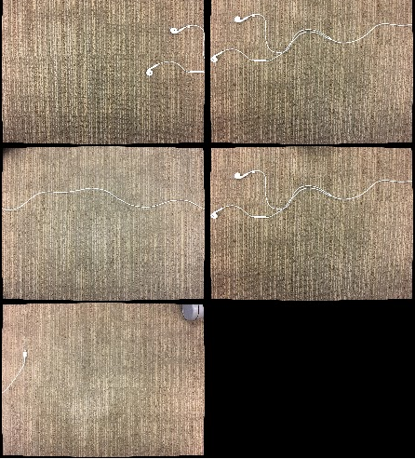
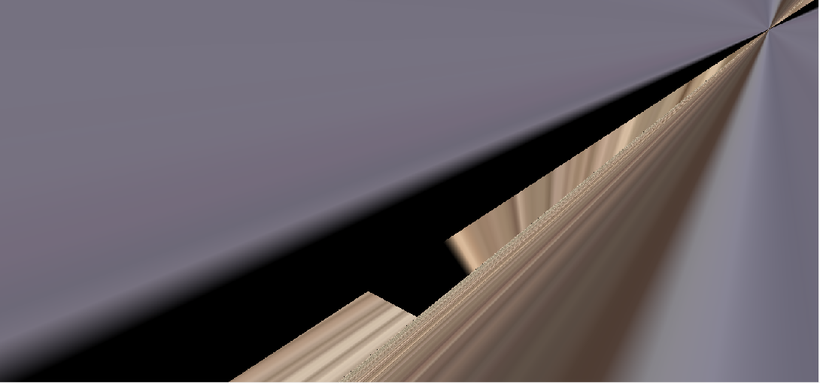
Small Overlap
For the last set of the images, I took 5 pictures from the floor in Snell library.
The left plot is the one after compensation, while the bottom is the one for panoramic mosaic
It seems like since there are too many featured points on the figure, which makes the harris feature detector confused about where might be the overlapping area.
One possible way is we might could manually add some reference point to the figure, to help the detector recognize.

